Slide 1
Business Process Workshop Purchasing Basics
Presented by:
Robby Bounds Patty Winkler
Executive Director Assistant Director
Procurement Services Procurement Services

Slide 2
Introduction
The purpose of this training is to provide employees with information about basic purchasing procedures and rules, and most importantly, get your questions answered! We will be covering the following topics:
University Purchasing Procedures
The NEW Delegated Purchasing Authority
No bidding required for purchases of $25,000 or less
Departments may obtain bids for purchases of $50,000 or less
And, if there is enough time…
Purchasing Categories
Historically Underutilized Business (HUB) Program

Slide 3
Code of Ethics
Texas A&M University is a member of the National Association of Educational Procurement (NAEP), and conforms to their Code of Ethics, as well as the Texas A&M University System Ethics Policy.
Note: To view the NAEP or Texas A&M University System Ethics Policy visit the following websites:
https://purchasing.tamu.edu/about.html
http://policies.tamus.edu/07-01.pdf

Slide 4
Code of Ethics
In discharging purchasing responsibilities, ALL* employees of Texas A&M University to whom purchasing authority has been delegated must maintain a standard of conduct in accordance with the System Ethics Policy. Employees whose behavior violates these standards of conduct will be subject to disciplinary action, including discharge if warranted by the seriousness of the offense. As an employee of a state-funded University, it is very important to exhibit high ethical standards and avoid situations that could appear to be a conflict of interest.
*This means you!
Purchasing guidelines for all employees to whom purchasing authority has been delegated is located at:
https://purchasing.tamu.edu/purchasing/Purchasing%20Guidelines.html

Slide 5
Purchasing Policies & Procedures
Why does the University have so many Purchasing Policies and Procedures?
To ensure that the University is compliant with State Law and A&M System Policy, and to defend the public trust of the people of Texas.
The University procurement process may seem cumbersome and time-consuming, but we are here to assist you in understanding the requirements.
To learn more, visit the following websites:
Purchasing Authority - http://policies.tamus.edu/25-07-03.pdf
Procedures - https://purchasing.tamu.edu/purchasing/purchasing-procedures.html
HUB Rule - http://rules-saps.tamu.edu/PDFs/25.06.01.M1.pdf

Slide 6
Delegated Purchasing Authority
NEW! As of June 1, 2023, the University’s Delegated Purchasing Authority allows departments to make purchases that are $25,000 or less REGARDLESS of funding source.
This amount is inclusive of all charges, including
installation, insurance, freight, and/or postage.
Departments are encouraged to obtain multiple quotes and seek out Historically Underutilized Business (HUB) vendors whenever possible. More information about the HUB Program is provided later in the presentation.

Slide 7
Delegated Purchasing Authority
Departments may not exceed the authorized delegated limit.
PURCHASES MAY NOT BE
INTENTIONALLY
divided to circumvent the authorized delegated limit or procurement process!
Departmental purchasing authority may be revoked for intentional misuse.

Slide 8
Purchases Over $25,000
Regardless of funding source:
ALL purchases of goods and services in excess of $25,000 must be processed through Procurement Services, unless specifically exempted by Purchasing Procedures.
https://purchasing.tamu.edu/purchasing/purchasing-procedures.html

Slide 9
Purchases Over $25,000
To ensure compliance, it is recommended that departments contact Procurement Services prior to ANY purchase in excess of $25,000 …even if you think it is specifically exempted by Purchasing Procedures..

Slide 10
Purchases Over $25,000
NEW! As of June 1, 2023, for purchases between $25,000 and $50,000, departments now have the option to solicit three or more informal bids (email bids are acceptable) with at least two of the three bids from Historically Underutilized Businesses (HUBs),then submit a requisition to Procurement Services with all bid documentation attached. This process is optional and not intended to add additional burden to department resources.
Procurement Services stands ready to assist with the solicitation process.

Slide 11
Purchases Over $25,000
Recommendations for successful bids:
Use the Centralized Master Bidders List (CMBL) to find vendors, especially HUBs: https://mycpa.cpa.state.tx.us/tpasscmblsearch/
To expedite the order, use vendors currently registered in AggieBuy.
Develop a list of vendors that fit your needs.
Keep specifications simple; i.e., specific make and model number, apples to apples comparison, supplies and equipment vs. services.
Stay away from services due to complex statements of work, difficult evaluation process, bonding and insurance requirements.
Give vendors time to respond.
Develop a tabulation sheet; see example.
Award based on low bid.
Attach all documentation in AggieBuy purchase requisition.
Vendor contract? Just say NO!

Slide 12
Purchases Over $25,000
Tabulation Sheet
Company
Address
City, State
Terms |  |  | Net 30 |  | Net 30 |  | Net 30
FOB |  |  | Destination |  | Destination |  | Destination
Delivery Days
Quoted by
VID #
HUB Status
AggieBuy (Yes/No)
# |  | Qty | Unit Price | Ext.Price | Unit Price | Ext.Price | Unit Price | Ext.Price
1 |  |  | $ - | $ - | $ - | $ - | $ - | $ -
2 |  |  | $ - | $ - | $ - | $ - | $ - | $ -
3 |  |  | $ - | $ - | $ - | $ - | $ - | $ -
4 |  |  | $ - | $ - | $ - | $ - | $ - | $ -
5 |  |  | $ - | $ - | $ - | $ - | $ - | $ -
6 |  |  | $ - | $ - | $ - | $ - | $ - | $ -
7 |  |  | $ - | $ - | $ - | $ - | $ - | $ -
8 |  |  | $ - | $ - | $ - | $ - | $ - | $ -
9 |  |  | $ - | $ - | $ - | $ - | $ - | $ -
10 |  |  | $ - | $ - | $ - | $ - | $ - | $ -
 | TOTAL |  |  | $ - |  | $ - |  | $ -

Slide 13
Purchases Over $25,000
Exempt Purchases
Regardless of cost, the goods and services listed on the following slides are exempt from competitive bidding requirements and may be purchased by departments. To ensure compliance, it is recommended that departments contact Procurement Services prior to ANY purchase in excess of $25,000. All purchases must follow 25.07.01.M1, Contract Administration and/or 25.07.01.M1.01, President’s Delegation of Authority for Contract Administration.
See Purchasing Procedures for complete description of exempt goods and services:
https://purchasing.tamu.edu/purchasing/purchasing-procedures.html

Slide 14
Purchases Over $25,000
Exempt Purchases (cont.)
Classified Advertising
Conference Expenses
Employee Moving Expenses
Lecturers/Guest Speakers
Student Travel
Library Materials
Legislative Information Services
Membership Fees/Dues
Direct Publications
Freight
Purchases From State Agencies, System Members, Local Governments
Registration Fees
Rental of Exhibit Space
Purchases from Texas Department of Criminal Justice
Purchases from WorkQuest
Internal Repairs
Purchases From Federal Agencies
Purchases From Institutions of Higher Education
Utilities
Purchases Through AggieBuy MarketPlace
Accrediting Organizations
Sponsorships
Visiting Scholars and Fellows
Many exceptions apply. It is recommended that departments contact
Procurement Services prior to ANY purchase in excess of $25,000.

Slide 15
Purchases Over $25,000
Exempt Purchases (cont.)
Purchases through AggieBuy MarketPlace
The $25,000 delegation limit does not apply to the purchase of items utilizing punch-out catalogs through the AggieBuy MarketPlace. These agreements have been put in place by Procurement Services and all competitive bidding requirements have been met.

Slide 16
Purchases Over $25,000
Sole Source Purchases
Sole Source and/or Proprietary products or services can be purchased only from a single source, are essential to the accomplishment of the work, must be properly justified in writing by the end user or other subject matter expert, and must be approved by Procurement Services.
Note: The PRICE of the product or service is NOT a consideration for approval of a sole source, as pricing can be determined only by competitive solicitation.
The sole source justification form may be found at: https://purchasing.tamu.edu/_media/sole_source_form.pdf
For more information on sole source purchases, contact the Procurement Services Department.

Slide 17
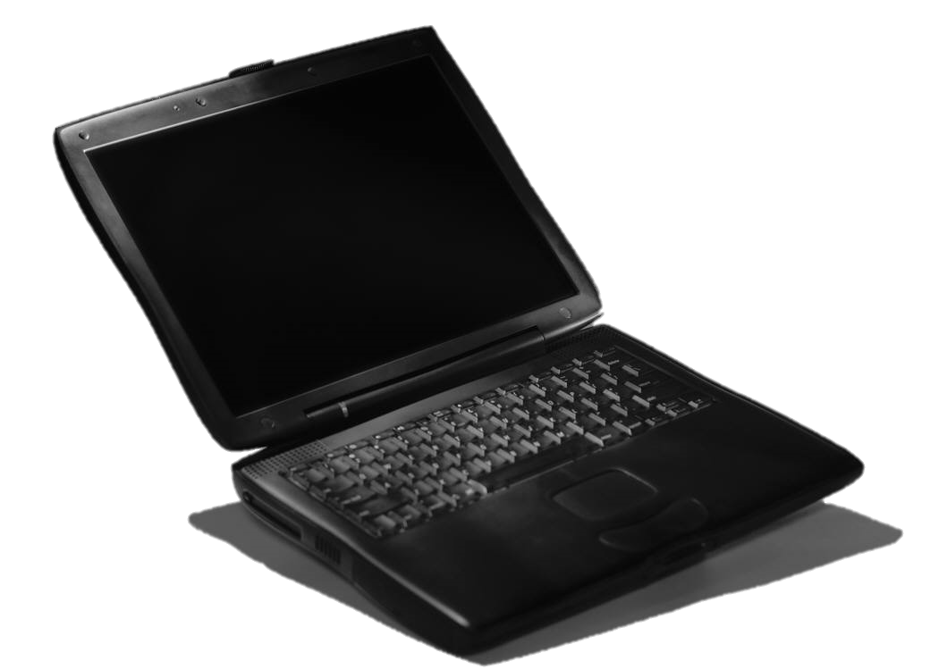
Purchases Over $25,000
Electronic and Information Resources
Electronic and Information Resources (EIR) are the procedures, computer equipment, computing facilities, software and data which are purchased, designed, built, operated and maintained to collect, record, process, store, retrieve, display, report and transmit information.
Departments are authorized to purchase EIR, including software, costing $25,000 or less when no contract is required, such as off-the-shelf products and shrink-wrapped software.
It is recommended that all software purchases over $25,000 be sent to Procurement Services for processing.

Slide 18
Purchases Over $25,000
Electronic and Information Resources (cont.)
All EIR purchases will be routed to IT Security for approval.
All EIR purchases in excess of $10,000 will be routed IT Accessibility for approval.
EIR purchased at or in excess of $250,000 requires approval of the TAMU CIO and TAMUS CIO prior to purchase.
ALL EIR requiring the execution of a license or support agreement must be submitted to Procurement Services prior to the purchase of the software.

Slide 19
Purchases Over $25,000
Purchase of Services – Recommended to be processed by Procurement Services
Many times, services are required from an outside company because
the University does not have the resources to complete the job. A Service is defined as the furnishing of skilled or unskilled labor or professional work but does not include: (1) professional services as defined by the Texas Government Code; (2) service of a state agency employee; (3) or service of a public utility.
If a service will be required and rendered throughout the fiscal year, with an estimated cumulative value that exceeds $25,000.00, a requisition must be forwarded to Procurement Services prior to any commitment being made to a provider of the services needed. Information must include:
Full description of services required
Time period of service (begin and end date)
List of deliverables
Suggested sources

Slide 20
Purchases Over $25,000
Professional Services
A Professional Service is defined as a person licensed as an Accountant, Architect, Landscape Architect, Land Surveyor, Physician, including a Surgeon, Optometrist, Professional Engineer, Real Estate Appraiser, Registered Nurse.
Requests for Professional Services with a value over $25,000.00 require the processing of a requisition through Procurement Services and may require a Request for Qualifications (RFQ) process. This is the selection of a vendor based on qualifications, not price.
Procurement Services will determine if the RFQ process is required and will work with you directly to define the project scope.

Slide 21
Purchases Over $25,000
Consulting Services
Consulting Service is the service of studying or advising a state agency under a contract that does not involve the traditional relationship of employer and employee.
With the exception of fund-raising consulting services, all other consulting services shall be processed as any other service as defined by University rule 25.07.03.M2.01 Section 3. Consulting Services in excess of delegated authority shall be requisitioned through Procurement Services.
To be compliant, an award must be issued through Procurement Services prior to the start of service.
Fund raising consulting services, of any dollar value, require additional routing prior to submission of a requisition to Procurement Services.

Slide 22
Purchases Over $25,000
Emergency Purchase
What is an emergency purchase?
The unanticipated purchase of goods or services that if not secured immediately, will cause the University to suffer operational or financial damage.
If an emergency purchase is required, each step of the process listed below is to be followed:
If possible, notify Procurement Services immediately to assist with the procurement process;
If Procurement Services is not available, obtain at least 3 informal bids except when securing bids would significantly impede the process of the purchase;
Place the order with the selected vendor;

Slide 23
Purchases Over $25,000
Emergency Purchase (cont.)
Enter an AggieBuy Purchase Requisition and include a completed Justification of Emergency Purchase Form found at: https://purchasing.tamu.edu/_media/justification-emergency.pdf. The form must completely describe:
The reason for the emergency purchase by explaining what the emergency is and/or what caused the emergency situation;
The financial and/or operational damage that will occur if needs are not satisfied immediately; and
Why the needs were not or could not be anticipated, so that the items could have been purchased through regular procurement procedures.

Slide 24
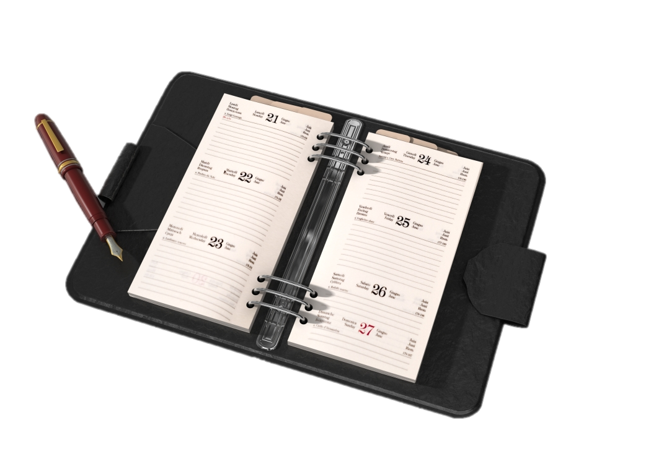
Purchasing Process - Timeframe
How long is this going to take!
For purchases in excess of $25,000, the procurement process is completely dependent on the size, complexity, statutory requirements and total value of the request. While an item selected from a vendor under an existing contract can possibly be awarded in less than a day, a complex Request for Proposal (RFP) can take months to develop, evaluate and award.
If the vendor requires a signed contract, this is a separate process through Contract Administration and may require additional time.
Contact the buyer assigned to your college or commodity to determine the specific steps involved on a particular purchase and the estimated timeframe. To help facilitate locating the appropriate buyer for a specific purchase go to:
https://purchasing.tamu.edu/purchasing/buyer-locator.html

Slide 25
HUB Program
What is a HUB?
To be certified as a Historically Underutilized Business (HUB), a business must meet the following criteria:
A for-profit entity that has not exceeded the size standard prescribed by 34 TAC 20.282, and has its principal place of business in Texas, and
Is at least 51 percent owned by an Asian Pacific American, Black American, Hispanic American, Native American, American woman and/or Service-Disabled Veteran, who resides in Texas and actively participates in the control, operations and management of the entity’s affairs.

Slide 26
HUB Program
Why buy from a HUB?
HUB purchases benefit the Texas economy. Because HUBs are located in Texas, they hire Texans, spend money in Texas and pay state taxes. Buying from HUBs keeps state revenue in Texas and ultimately benefits Texans;
HUB purchases provide economic opportunities previously unavailable to minority, women or service-disabled veteran-owned businesses;
State law and A&M System policy require a good faith effort to purchase from HUBs;
Poor HUB performance can lead to loss of state funding and negative audit findings; and
It’s the right thing to do!

Slide 27
HUB Program
You can find additional information regarding the Texas
A&M University HUB Program at the following link:
http://hub.tamu.edu/

Slide 28
Questions!
Contact:
Additional information regarding purchasing and the information covered in this presentation can be found at the Procurement Services homepage.
Procurement Services
http://purchasing.tamu.edu/
979-845-4570

