Slide 1
Wire Transfers
Notes:
Introduce ourselves- please interrupt if you have a question as we go along

Slide 2
Requesting Wire Transfers
Banking must receive your request for a wire from AP Auditors prior to 10:00 a.m. in order for it to be processed that day. If it is received after 10:00 a.m. it will be processed the following business day. All wire requests must go through the AP process prior to banking getting the documents.
Banking assigns a wire transfer number to each request and logs it in the wire transfer log. If you need to know the date a wire was done, Banking can give you that information from their log.
This Photo by Unknown Author is licensed under CC BY-SA
Notes:
If you need the confirmation number or the wire number, they can be found on the AB document attachments as WTXXXX

Slide 3
Wire Transfer Amounts
Wire transfers can be sent in US dollars or a foreign currency. When paying an invoice, it is best to pay in the requested currency. When paying an individual, please confirm their preference. Not all bank accounts will accept US dollars, and some will charge the beneficiary a fee to convert. Domestic wires will always be sent in US dollars.
We can pay the USD equivalent. For example, to pay an individual $1,000.00 for a speaking fee, if their account only accepts Euros, we can send the USD equivalent on that date. Specify which currency on the wire transfer request to avoid delays in processing.
Some countries have restrictions regarding payment in the local currency, such as a minimum amount or additional information required.
Notes:
Some countries allow for USD only accounts with specific IBANS and they also can have accounts for different currencies and IBANS for them. If money is sent in wrong currency sometimes they will return the wire back to TAMU and their bank deducts a fee. Other times they will charge vendors for conversion fees, and now the vendor will not be paid in full.

Slide 4
Domestic Wires
A domestic wire is when funds are being wired inside the United States. Information needed will be an Account number, Routing number and Beneficiary name (which must match the vendor name in AggieBuy).
Notes:
Talk about submitting proper paperwork to Vendor Setup for DBAs to avoid delays in processing
Please have vendors verify with their Financial Inst. The correct routing number/ EX WF has different routing numbers ACH wires checks
Also they should verify if an intermediary bank is required (ex credit unions)

Slide 5
International Wires
If you are sending funds outside the United States, this is considered an International wire. Information needed to send this type of wire includes:
Account number, IBAN (if the country requires it), or CLABE number (Mexico)
Beneficiary name (this must match the vendor name in AggieBuy)
Beneficiary City
Beneficiary phone number
Swift code / IRC (International Routing Code) (if applicable)
Purpose of payment (department needs to get this from the beneficiary; it's different for different countries)
Additional information may be required from some countries, but that will be requested as needed.
Notes:
Additional information can include beneficiary phone number (Brazil) Address (Canada)…Vendors need to indicate what SWIFT/IBAN to use if multiple are listed on the invoice.
Verify if an Intermediary bank is required.

Slide 6
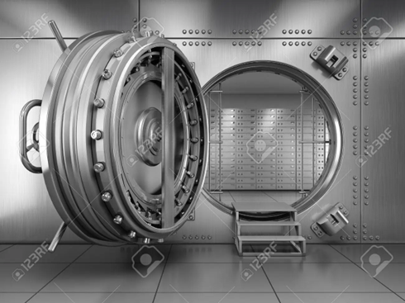
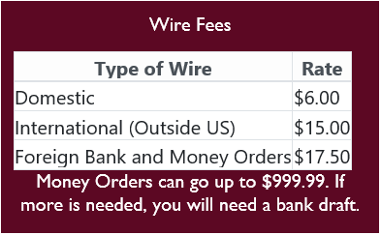
Wire Fees
The wire fees will be charged to the account indicated by the AP Auditor.
Notes:
Foreign Bank Drafts*** Make sure accounts are not over budget and/or the account used supports this type of fee. The object code is 5231-service charges

Slide 7
Time Frame for Wires
US dollar domestic wires hit the vendor's bank the same day as initiated and approved.
US dollar international wire (to a foreign bank) leaves our bank the same day; however, we have no control over when the foreign bank posts the funds to their customer's account.
Foreign currency wire has a 2-day waiting period in our bank. The wire leaves our bank on the 2nd business day; however, we have no control over when the foreign bank posts the funds to their customer's account.
This Photo by Unknown Author is licensed under CC BY-SA-NC

Slide 8
INCOMING WIRES

Slide 9
Incoming Wires
Reports are run daily to determine if any of our accounts have received funds via wire transfer.
Vendors should include the following information in the wire transfer details:
The receivable or invoice number
Department name
Department account number
Email vpfn-banking-recon@tamu.edu to request banking instructions to provide to vendors needing to send you money.
Notes:
If you need to give a vendor our banking information, email us vpfn-banking-recon@tamu.edu.

Slide 10
Incoming Wires
Are you expecting money? Let us know.
When funds are received, we notify the department by sending an email with detailed instructions of how to post the funds to the department’s account.
If you are contacted for an incoming wire, and the funds are not for your department, please respond and notify Banking so we can identify the proper recipient.
This Photo by Unknown Author is licensed under CC BY-NC-ND

Slide 11
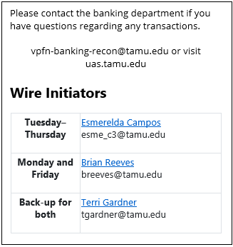

Slide 12
QUESTIONS?

